Slide 1

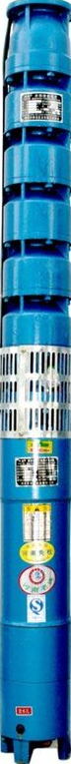
Stainless Steel Flow Shrouds force water to travel past your pump's motor before entering the pump intake. Submersible motors need cool water moving past them to pull away heat. If your pump is in a very wide well or open water, the water takes the shortest path and bypasses the motor. This can cause the motor to overheat and fail.
Project Name: Project #:
Well Casing Min. I.D. = ”
Open Hole or Screen Min. I.D. = ”
“If” there is sufficient annular space between shroud and well I.D., place a ¼” thick band around O.D. to hold tube during installation. Placed 1’ down from top.
Top Steel Donut “ x “ x ½” to fit inside tube O.D. Drill, tap and screw. Cable Notch “ x “
Bowl Assembly O.D. = “
Bowl Assembly Length = “
Motor O.D. = “ Motor Length = “
Bowl/Motor Overall Length = “
Shroud Cooling Calculations:
V = .409 X GPM
(Shroud ID)² - (Motor OD)²
V = .409 X GPM
( ”)² - ( ”)²
V = ft per second
*Confirm with Manufacturer Motor Information
Schedule 10 Stainless Steel Tube(s): ~0.15” thick
Qty. ( ) “ ID x “ OD x “ Long.
Weld together. Shroud Overall Length = “
Bottom Steel Donut “ x “ x ½” to fit inside tube O.D. Drill, weld.
“ Stainless Steel Adapter Tube,
Plain end x (TBD)

